Slide 1
Living and non-living things
Grass
Cement
Mould
Paper
Tennis ball
Living things
grow,
change,
and reproduce themselves
Ice cream
Barramundi
Dogs
Germs
Mites
Notes:
This unit looks at how living things move and reproduce using three examples: dogs, mites and germs.

Slide 2
Living and Growing
Barramundi
Mould
Grass
Dogs Mites Germs
Living things grow, change, and reproduce themselves
Notes:
This unit looks at how living things move and reproduce using three examples: dogs, mites and germs.

Slide 3
Living and Growing
Dogs Mites Germs

Slide 4
Just like all mammals, dogs need
a male and female to make puppies.

Slide 5
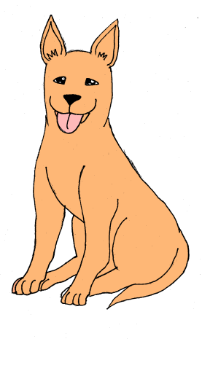
Girls dogs can have puppies
from 6 months old

Slide 6
Girl dogs can have
two litters of puppies
every year.
Click on the screen to see what that looks like…

Slide 7
Living and Growing
Dogs Mites Germs

Slide 8
What are Mites?
Mites are like little animals, like little ticks, but much smaller.
Scabies mites can cause scabies.

Slide 9
This is a mite
She is very small.
.

Slide 10
This is a mite.
.
She is very small.
Let’s use a magnifying glass to make her bigger.

Slide 11
This is a mite.
.
We can just see her!
Let’s look closer under a microscope.

Slide 12
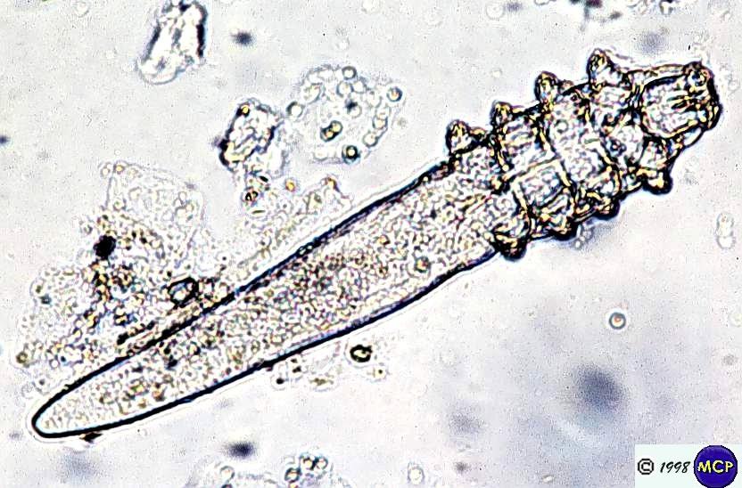
Mange mite
Demodex
Notes:
Mites are like little animals, little ticks, but too small to see

Slide 13
Mange mite
Demodex
Notes:
Mites are like little animals, little ticks, but too small to see

Slide 14
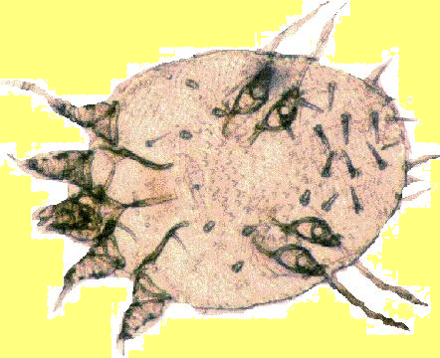
Mange mite
Sarcoptes

Slide 15
How does Mange
spread
in Dogs?

Slide 16
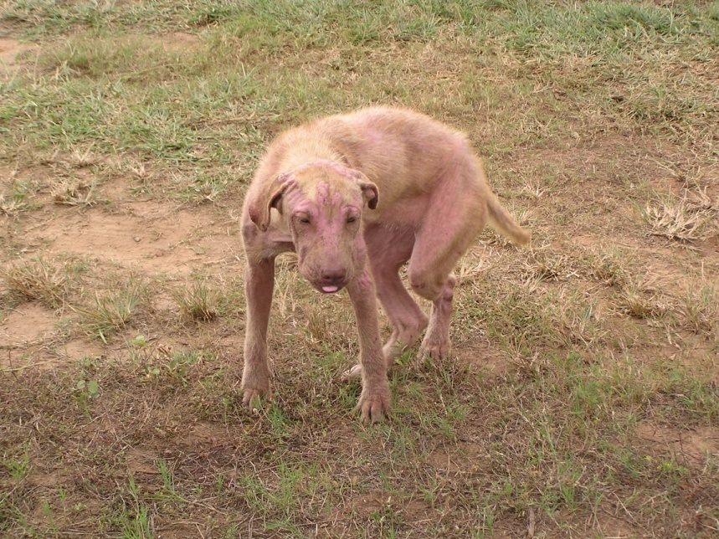
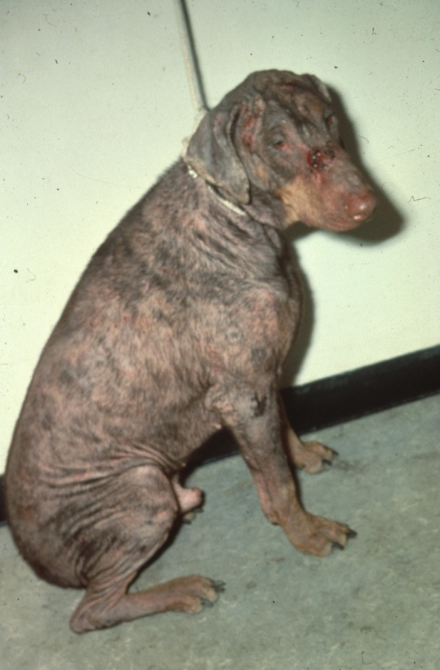
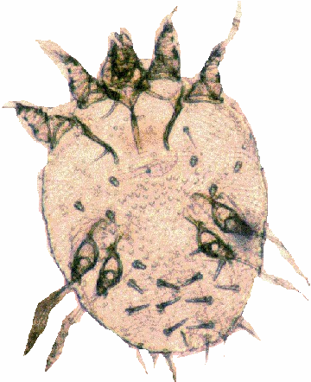
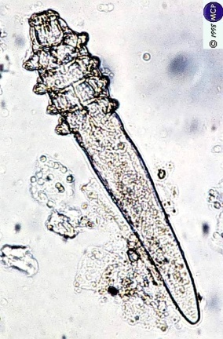
Mites can cause mange in dogs, and make people itchy too.
Notes:
There are different kinds of mange mites, demodex and sarcoptes. Sarcoptes is round and easy to kill.

Slide 17
Adult mites
lay eggs
This life cycle takes about 1 month.
The baby mites grow up into adult mites.
The eggs hatch, and more mites come out.
Mange mite
Sarcoptes
Notes:
Like ticks and birds and lizards, mites lay eggs, and the eggs hatch making more mites. This takes about one month

Slide 18
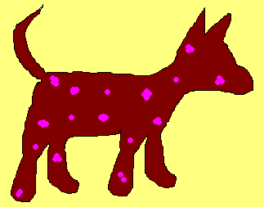
Mites live in the skin.
They make a dog itchy
so they loose their hair.
Notes:
The mites live in the dogs skin. A dog with only a few mites may look normal. But soon they make the dogs itchy and lose hair. The weaker the dog the faster this happens.

Slide 19
Mites make tunnels, crawling around under the skin.
Notes:
The mites are tunneling through the skin like ants or termites through the ground. The body knows they should not be there and fights the mites. This makes the skin itchy. The hair falls out when the dogs scratch.

Slide 20
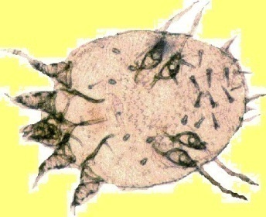
How does
mange spread
in dogs?
Mange crawl using their legs…

Slide 21
Mange mites can walk from one dog to another
Notes:
Eggs can roll off the dogs into bedding too, and get onto other dogs that way

Slide 22
Treating some dogs doesn’t stop the problem
The drug wears offs and the mites crawl back on
One dog spreads mange to others
Notes:
Mange spreads through dog population. Treating dogs with medicine will make them better, but if any are missed, it will spread again. That’s why its important to do as many dogs as possible.

Slide 23
The mange medicine kills the mites
but doesn’t kill the eggs

Slide 24
The mange medicine kills the mites
but doesn’t kill the eggs

Slide 25
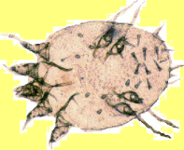
The eggs will hatch making more mites

Slide 26
So we need to get rid of the eggs before they hatch
Or use the mange medicine again

Slide 27
How
can we
get rid of
eggs?

Slide 28
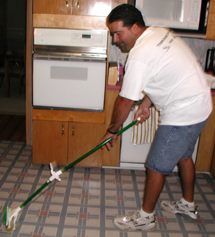
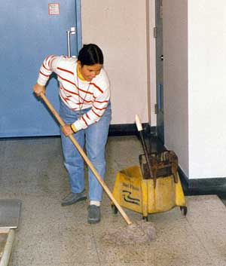
We can get rid of eggs by cleaning out our houses and washing all the blankets

Slide 29
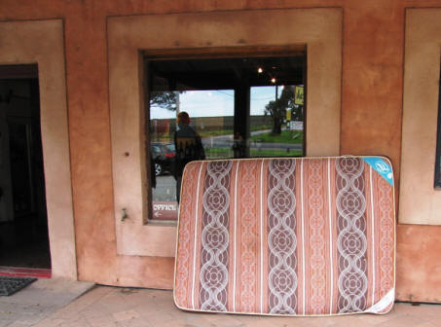
Mites also don’t like the sun, so getting lots of sunlight on things like mattresses will help control them

Slide 30
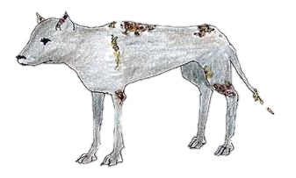
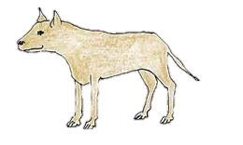
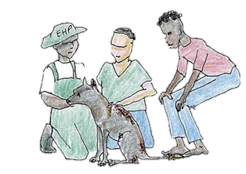
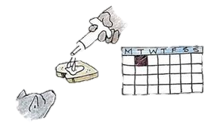
How to treat dogs for mange mites
Mange mite has left the dog with sores and missing hair
Treating the dog for mange mite
Treated dog with all it’s hair.
Ivermectin or any other anti parasite medicine can be use to kill the mites. Place this on a piece of bread with meat paste.
The dog eats the bread with medicine. A dog may need several treatments if mange is bad

Slide 31
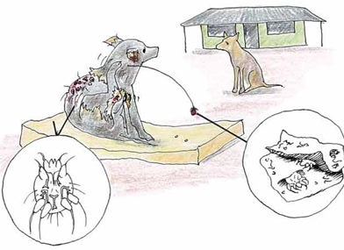
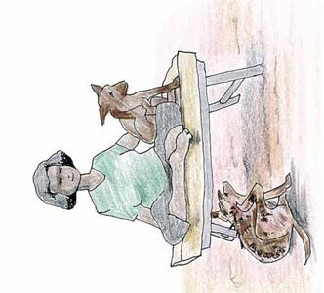
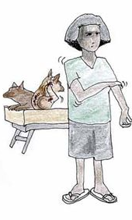
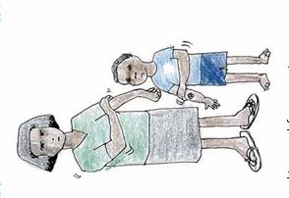
How do dogs spread Scabies to Humans
Scabies mites spread from dogs onto bedding.
The scabies mites can jump from dogs or infected bedding onto people.
The scabies mite can make people itch for a few weeks.
The scabies mite can make the family itchy. If you have any itchy sore’s you need to go to the clinic.
Notes:
Scabies Mites, while they do not live on our skin as they do in dogs, they will when in contact with our skin bite and cause irritation. It is the bite that causes people to itch which results in an open sore. Open sores on people can get infected with bacteria. The main type of bacteria that gets into peoples sores is ‘Streptococcal Bacteria’.
Steptococcal or Strep causes Rhumatic Feaver which damages the heart and kidneys. These organs will never repair and the damage last forever.

Slide 32
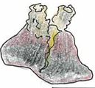
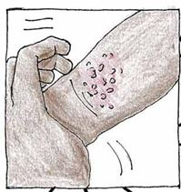
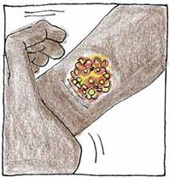
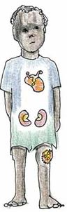
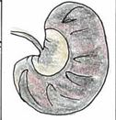
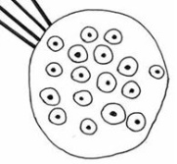
If we don’t get treated for Scabies what happens?
The skin becomes itchy.
The itching causes open sores.
The open sore becomes infected and bacteria gets into the sore.
The open sores get infected with the Streptococcal Bacteria. Strep leads to Rheumatic Fever and damages the kidney a heart.

Slide 33
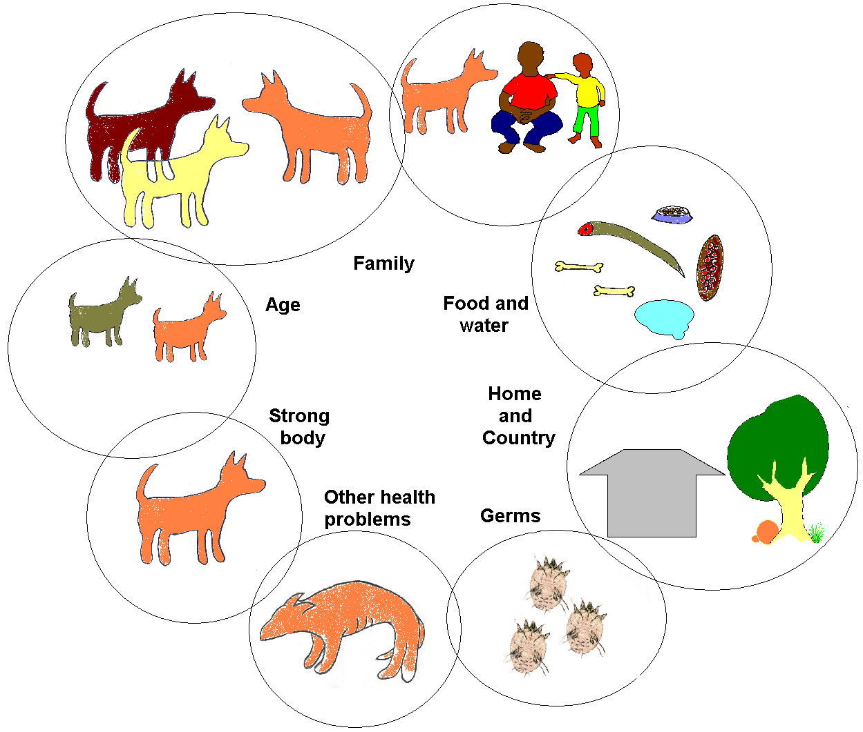
Notes:
Disease isn’t just caused by mites. Dogs and People being healthy depends on many things: the health of our home and community, the healthiness of our food and drink, the happiness of our family, how young or old we are, and other health problems we might have.

Slide 34
Living and Growing
Dogs Mites Germs

Slide 35
This is Mr Germ
He is very, very small.

Slide 36
This is Mr Germ
He is very, very small.
Let’s use a magnifying glass to make him bigger

Slide 37
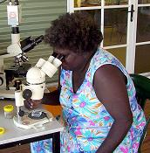
This is Mr Germ
He’s still too small to see!
We’ll need a microscope.

Slide 38
This is Mr Germ under a microscope.
How is he moving?

Slide 39
Let’s look closer.

Slide 40
He has little legs called cilia.

Slide 41
His tiny legs move him tiny distances.

Slide 42
Oh! What is he doing?

Slide 43
Mr Germ split in two.

Slide 44
Mr Germ reproduced himself.

Slide 45
Germs can reproduce very quickly.

Slide 46
Germs can reproduce very quickly.

Slide 47
Germs can reproduce very quickly.

Slide 48
Let’s make a graph to see how fast germs reproduce.
19 -
18 -
17 -
16 -
15 -
14 -
13 -
12 -
11 -
10 -
9 -
8 -
7 -
6 -
5 -
4 -
3 -
2 -
1 -
On the side we can measure how many germs we have.
On the bottom we measure how much time has gone by.
I I I I I I I I I I I I I I I I I I I I I I I
5 10 15 20 25 30 35 40 45 50 55 60 65 70 75 80 85 90 95 100 105 110

Slide 49
What do you think the graph will look like?
19 -
18 -
17 -
16 -
15 -
14 -
13 -
12 -
11 -
10 -
9 -
8 -
7 -
6 -
5 -
4 -
3 -
2 -
1 -
Like this?
Then like this?
Or maybe like this?
Let’s find out…
Let’s find out…
That would mean
there are less germs
as time goes on.
I I I I I I I I I I I I I I I I I I I I I I I
5 10 15 20 25 30 35 40 45 50 55 60 65 70 75 80 85 90 95 100 105 110
Time (s)

Slide 50
First get a big ball of plasticine to represent Mr Germ. Plasticine isn’t alive, so it won’t grow, but it splits just the same way.
19 -
18 -
17 -
16 -
15 -
14 -
13 -
12 -
11 -
10 -
9 -
8 -
7 -
6 -
5 -
4 -
3 -
2 -
1 -
I I I I I I I I I I I I I I I I I I I I I I I
5 10 15 20 25 30 35 40 45 50 55 60 65 70 75 80 85 90 95 100 105 110
Time (s)

Slide 51
Split the plasticine in half every time Mr Germ splits himself.
19 -
18 -
17 -
16 -
15 -
14 -
13 -
12 -
11 -
10 -
9 -
8 -
7 -
6 -
5 -
4 -
3 -
2 -
1 -
I I I I I I I I I I I I I I I I I I I I I I I
5 10 15 20 25 30 35 40 45 50 55 60 65 70 75 80 85 90 95 100 105 110
Time (s)

Slide 52
Ready?
19 -
18 -
17 -
16 -
15 -
14 -
13 -
12 -
11 -
10 -
9 -
8 -
7 -
6 -
5 -
4 -
3 -
2 -
1 -
Steady?
Go!
I I I I I I I I I I I I I I I I I I I I I I I
5 10 15 20 25 30 35 40 45 50 55 60 65 70 75 80 85 90 95 100 105 110
Time (s)

Slide 53
If germs split in two every 10s…
19 -
18 -
17 -
16 -
15 -
14 -
13 -
12 -
11 -
10 -
9 -
8 -
7 -
6 -
5 -
4 -
3 -
2 -
1 -
I I I I I I I I I I I I I I I I I I I I I I I
5 10 15 20 25 30 35 40 45 50 55 60 65 70 75 80 85 90 95 100 105 110
Time (s)

Slide 54
In one minute there will be too many to count on our graph!
19 -
18 -
17 -
16 -
15 -
14 -
13 -
12 -
11 -
10 -
9 -
8 -
7 -
6 -
5 -
4 -
3 -
2 -
1 -
I I I I I I I I I I I I I I I I I I I I I I I
5 10 15 20 25 30 35 40 45 50 55 60 65 70 75 80 85 90 95 100 105 110
Time (s)

Slide 55
Germs are healthiest are strongest when all their needs are met. Germs need:
Food
Water
Shelter
Warmth
Company

Slide 56
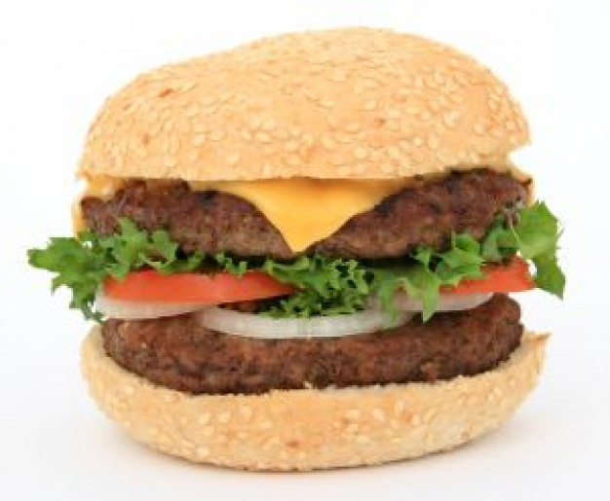
When warm, juicy food like hamburgers are left out of the fridge, germs from our hands, from the air and from flies grow very quickly on them.

Slide 57
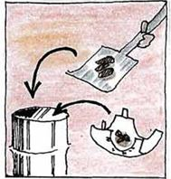
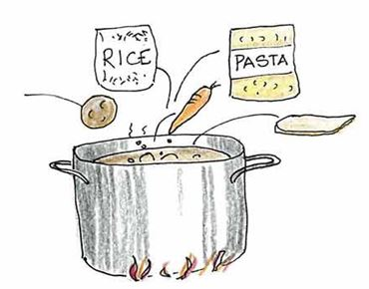
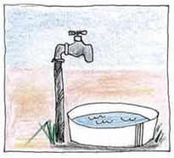
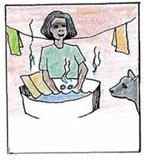
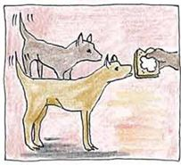
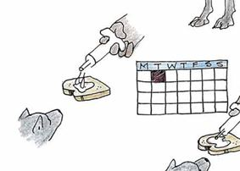
How to stop the spread of germs
Put rubbish in the bin
Make sure your food is covered and kept in the fridge.
Make sure your family and your dogs have clean drinking water
Wash bedding and clothing regularly
Wash hands after patting your dog and before eating.
Make sure you dog is desexed and has medicine for skin and parasites.

Slide 58
Some germs are good for us, but too many germs can make us sick.
Understanding how quickly
germs, mites and dogs grow
helps us to make decisions
to stay healthy.

